Slide 1
Improving Preparedness of Communities for Evacuations using ZEVs
Workshop #2 With Community Partners
Modeling of a real-world evacuation in Mariposa, CA Dr. Qijian Gan
Prof. Scott Moura
PATH UC Berkeley

Slide 2
Outline
Introduction
A Microsimulation Platform in Aimsun for EV Charging and Evacuation
Module for EVs and Fixed/Mobile Charging Stations
Module for Vehicle Evacuation
Module for Performance Evaluation
Modeling of a real-world evacuation in Mariposa, CA
The Mariposa Network
Existing and Potential Charging Stations
Three Case Studies with Synthetic Demand
Next Steps

Slide 3
Part I: Introduction

Slide 4
Current Challenges
Regulated by CA Executive Order N-79-2, we expect 100% sales of light-duty Zero Emission Vehicles (ZEV) by 2035.
However, there are a lot of challenges that need to be addressed to support the statewide transition to ZEVs.
Is the power grid able to support the charging of a large amount of EVs, especially when natural hazards occur (e.g., wildfire, flood, and extreme heat)?
How many more charging stations are needed? Where should we place these new charging stations?
Are we ready to deal with evacuations using EVs? ​What could be the challenges?​
How to minimize charging time/queuing during the evacuation of EVs? ​Mobile charging stations as an option?
How can we evaluate the performance of the proposed charging station placement strategies and evacuation plans for EVs?
Etc.

Slide 5
Our Research Goals
State-of-the-art studies on the placement of charging stations and evacuation plans usually rely on the macroscopic-level planning and/or optimization tools.
There is a lack of a performance evaluation platform at a high granularity with more practical settings in penetration rates of EVs, charger powers, availability of chargers, battery capacities/ranges, temperatures, road configurations, and traffic conditions.
In this research, we want to
Develop a microsimulation platform for EV charging and evacuation that can support various needs for stakeholders.
More realistic assessment of network/link/TAZ-level energy needs for EVs, e.g., Charging Corridor vs. Charging Communities
Identification of hotspots/bottlenecks of EV charging demand & performance assessment of the placement of EV charging stations
Performance assessment of EV evacuation strategies/plans, especially with Mobile Charging Stations (MCSs)
Develop a real-world evacuation scenario, e.g., in Mariposa, CA, to demonstrate the value of the developed microsimulation evaluation platform.

Slide 6
Part I: A Microsimulation Platform for EV Charging and Evacuation

Slide 7
System Design
Aimsun
Simulation parameter settings
Core Simulation Engine
Vehicle routing & charging station management
Simulation outputs
Performance Measures
Microscopic Free-flow aCceleration (MFC) Model and Battery Consumption Model for Electric Vehicles
Module for Vehicle Charging and Charging Station Management
Configuration of charging stations and chargers
Vehicle routing & road closure management
EV Routing and Scheduling
Configuration of evacuation zones and emergency shelters
Module for Mixed Traffic Evacuation
MCS Placement Strategies
Modules to be developed
Data flows to be developed

Slide 8
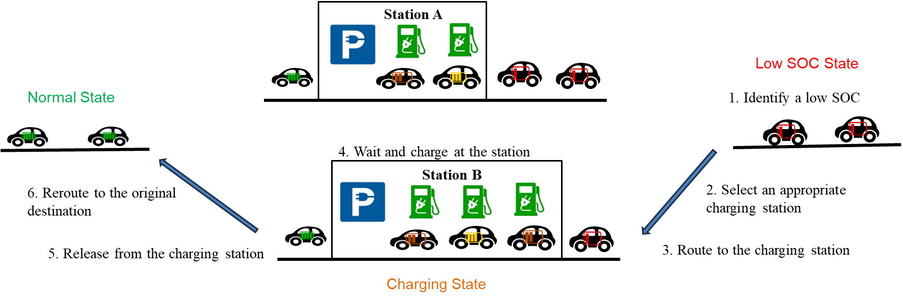
Module for EV Charging and Charging Station Management (1/2)
This module can replicate the real-world EV charging process.

Slide 9
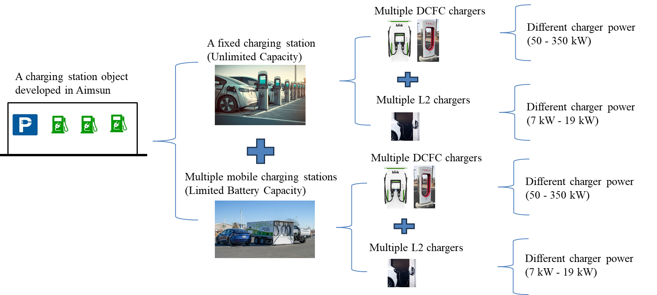
Module for EV Charging and Charging Station Management (2/2)
This module is flexible to configure the charging stations with the following:
Fixed and/or mobile charging stations → Modeled as centroids in Aimsun
Different charger types
Limited space with a maximum number of EVs allowed

Slide 10

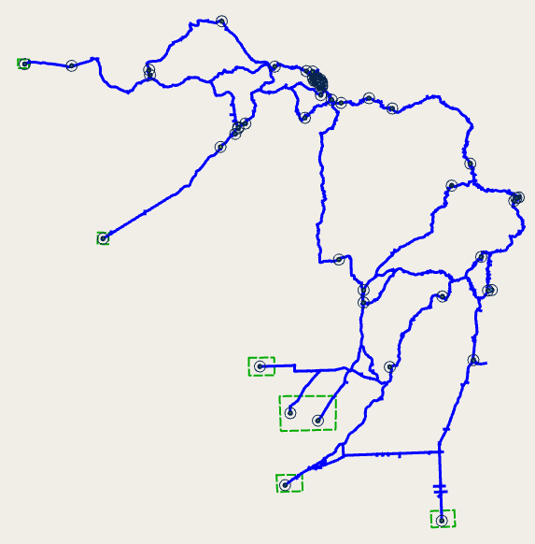

Module for Mixed Traffic Evacuation (1/2)
This module supports the simulation of vehicle evacuations in a mixed traffic environment.
Case 1: vehicles that have destinations in the evacuation zone(s) but are not yet assigned will not enter the network.
Case 2: vehicles that have destinations in the evacuation zone(s) and are already in the network will be detoured to one of the nearest emergency shelters.
Evacuation Zone
Evacuation Zone
Emergency Shelter
Emergency Shelter

Slide 11
Module for Mixed Traffic Evacuation (2/2)
Case 3: vehicles that have origins in the evacuation zone(s) will be detoured to one of the nearest emergency shelters.
Case 4: vehicles that have paths crossing in the evacuation zone(s) will be detoured to bypass the evacuation zone(s).
Evacuation Zone
Evacuation Zone
Destination
Emergency Shelter
Emergency Shelter
This module can enable a certain percentage of vehicles to follow the evacuation routes if available.

Slide 12
Module for Performance Measures
This module outputs the following measures and statistics to assess the performance of charging station placement strategies and evacuation plans.
Real-time charging station status
DCFC/L2 EVs served/being charged/waiting, DCFC/L2 chargers available/being used/inactive, current battery consumptions for fixed/mobile charging stations, etc.
Real-time link status
Time, average speed/flow/density in the last time interval
Statistics
Network performance summary: Number of vehicles/EVs entered, network battery consumption, number of EVs failed to find a charging station/run out of battery, total network VMT/VHT, etc.
Charging station summary: DCFC/L2 EVs served/being charged/waiting, total battery consumptions for fixed/mobile charging stations, etc.
Link battery consumption summary: Average speed/flow/density, total travel distance/time, total battery consumed, etc.
EV exit statistics: Initial/final SOC, battery consumed, total travel distance, etc.
Log information for EVs failed to find a charging station

Slide 13
Part II: Modeling of a real-world evacuation in Mariposa, CA

Slide 14
Why Evacuation Use Cases for Mariposa, CA?
Due to the rapid increase in ZEV ownership in recent years, rural areas like in Mariposa are facing a big challenge in the evacuation using ZEVs.
These rural areas normally lack charging facilities to support mass evacuations using ZEVs.
The transportation networks are vulnerable to mass evacuations.
Very limited routes to nearby cities.
These routes normally consist of state highways that are 2-lane roadways. Therefore, any traffic incident happening on the roadway will significantly degrade the evacuation effectiveness and efficiency.
Changes to traffic control at arterial intersections are needed to support the large volume of vehicles traveling in the dominated direction.

Slide 15

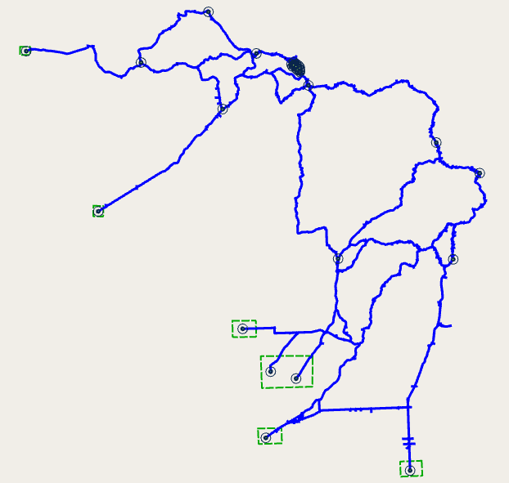
The Mariposa Network
We modeled the major arterials in the town of Mariposa, the state highways, and other 2-lane roadways.
Road geometry and speed limits have been updated to match those in the filed.
We consider the scenario of evacuating the residents in the town of Mariposa, CA to a safer place (to nearby cities in the central valley), due to a natural disaster (e.g., wildfire).
Key components
Evacuation Zones
Emergency Shelters
Charging Stations
Normal & Evacuation OD Demand, Signal Control Settings (On-Going)

Slide 16
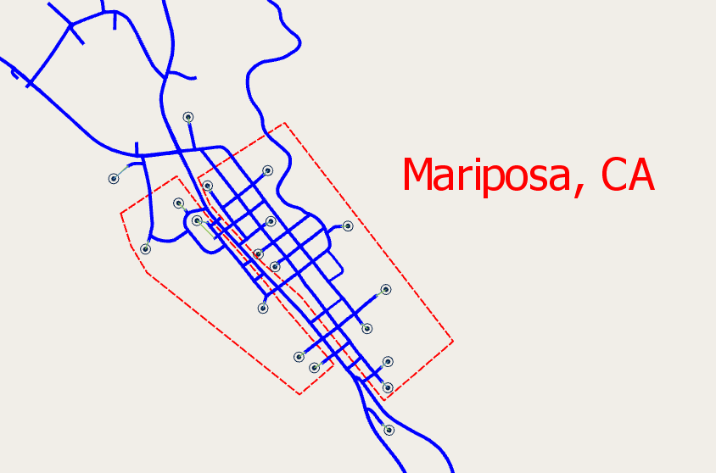
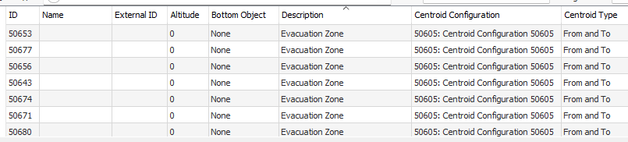
Setting of Evacuation Zones
The developed platform supports the modeling of multiple evacuation zones.
For example, we created two evacuation zones in the town of Mariposa, CA.
Centroid configuration in the model
Need to specify “Evacuation Zone” in the centroid description.
Evacuation Zone 1
Evacuation Zone 2

Slide 17
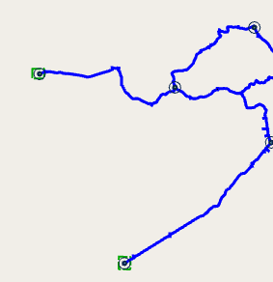
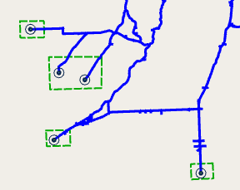
Setting of Emergency Shelters
The developed platform also supports the modeling of multiple emergency shelters.
For example, we created six emergency shelters (destinations) in the study area.
Snelling, CA
Planada, CA (To Merced, CA)
Ave 26 (To Chowchilla, CA)
Valley Lake Ranchos & Lake Madera Country Estates (To Madera, CA)
Centroid configuration in the model
Need to specify “Emergency Shelter” in the centroid description.
Madera, CA
Rolling Hills, CA (To Fresno, CA)

Slide 18
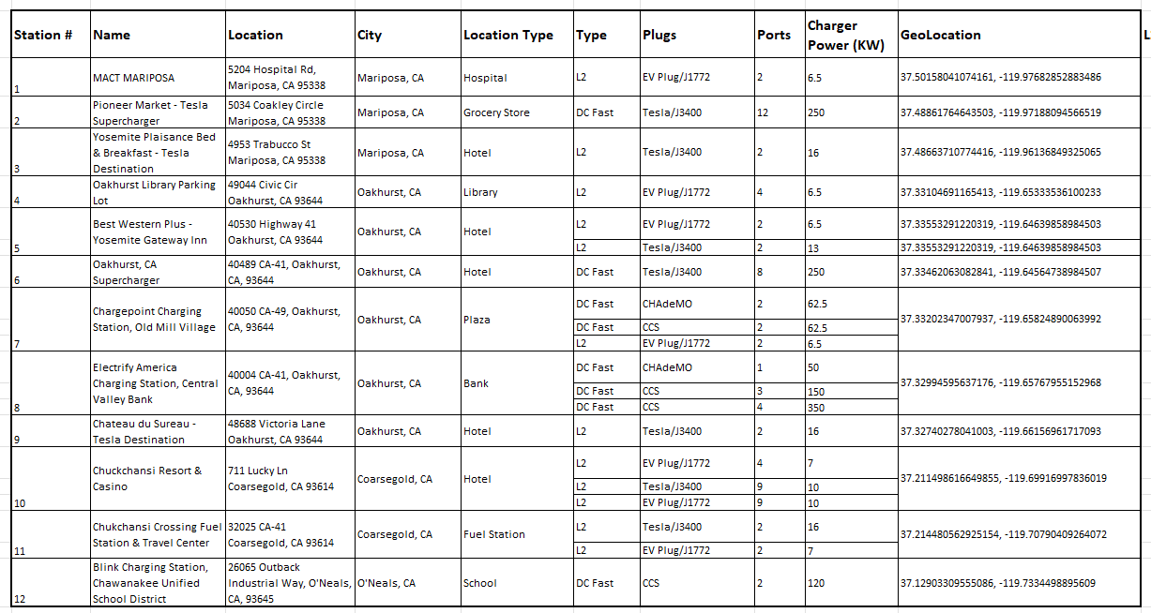
Setting of Charging Stations (1/4)
Currently there are only 12 public charging stations within the study network.
A total of 42 L2 chargers
A total of 34 DC Fast chargers
References: https://chargehub.com/map/#/en/map; https://www.tesla.com/findus; https://afdc.energy.gov/fuels/electricity-locations#/find/nearest?fuel=ELEC

Slide 19
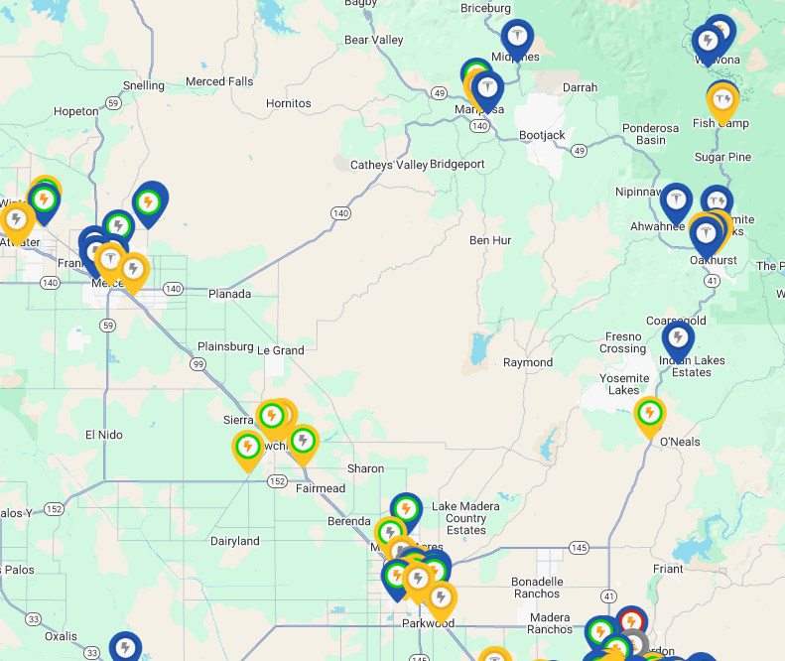
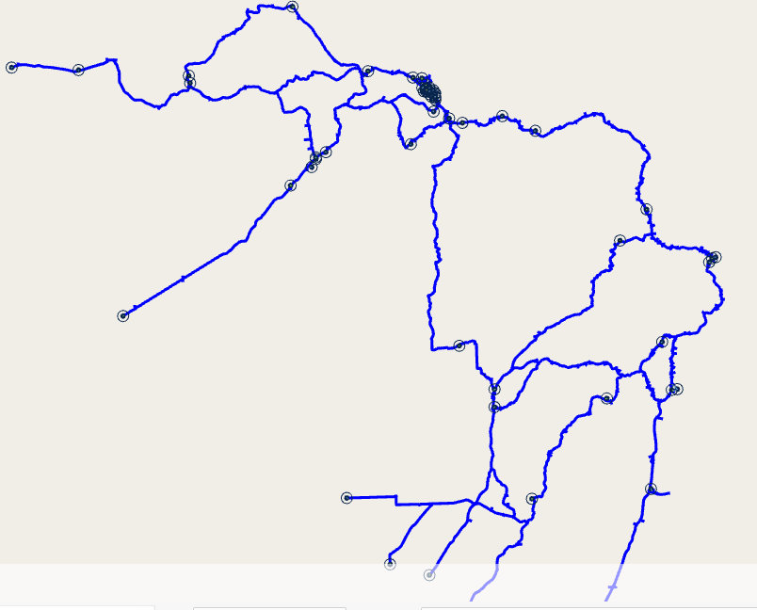
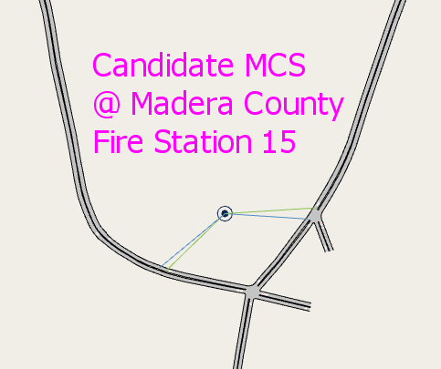
Setting of Charging Stations (2/4)
A large area of the study network is not covered by any charging station.
We added candidate locations (e.g., fire station, fuel station, hotel, grocery store/plaza, and school/library) that have enough parking space to support the deployment of Mobile Charging Stations (MCSs).
Areas that are hard to find candidate locations for MCSs

Slide 20
Setting of Charging Stations (3/4)
A total of 34 centroids were created for existing and candidate charging stations.
9 centroids for existing charging stations
25 centroids for candidate mobile charging stations

Slide 21
Setting of Charging Stations (4/4)
We modeled charging stations as centroids
Centroid configuration in the model
Need to specify “Charging Station” in the centroid description.

Slide 22
A Test Scenario with Synthetic Demand
Three vehicle types
Car
Car – EV DCFC → Can use both DCFC and L2 chargers
Car – EV L2 → Can only use L2 chargers
1-hr simulation (08:00-09:00)
1-hr synthetic traffic demands (a total of 3000+ vehicles)
0%EV, 10%EV, 20%EV, 30%EV, 40%EV, 50%EV
For EVs, 80% Car – EV DCFC and 20% Car – EV L2
30-min warn-up period
Initial SOC distribution
High at-home charge rate: Normal distribution with mean 80% and deviation 30%
Low at-home charge rate: Normal distribution with mean 50% and deviation 30%
Charging Stations
Baseline scenario: with only fixed charging stations
Alternative scenario: with Mobile Charging Stations added
SOC Thresholds
LOW SOC: 20%
Targeted SOC: 80%
Evacuation (if enabled) starts at 8:15AM and ends at 9:00AM

Slide 23
Case Study: Induced VMT, Energy Demand, etc.
A baseline scenario
With existing fixed charging stations
High at-home charge rate ~ N(80%,30%)
No evacuation activated
Results Averaged Over 5 Simulation Runs
EV Percentage | 0% | 10% | 20% | 30% | 40% | 50%
Total VMT (miles) | 45001 | 45229 | 46204 | 46118 | 46411 | 44323
Energy Demand (KWH) | 0 | 784.33 | 1621.28 | 2504.84 | 3329.22 | 4057.56
# of EVs Failed to Find a Charging Station | 0 | 13 | 27 | 44 | 52 | 62
# of EVs Run Out of Battery* | 0 | 1 | 7 | 11 | 11 | 14
Increased VMT due to the need to look for a charging station
Increased energy needs due to the rapid increase in EV ownership
A higher failure rate as the percentage of EVs increases.
*EVs that run out of battery will be removed from the network/simulation.

Slide 24
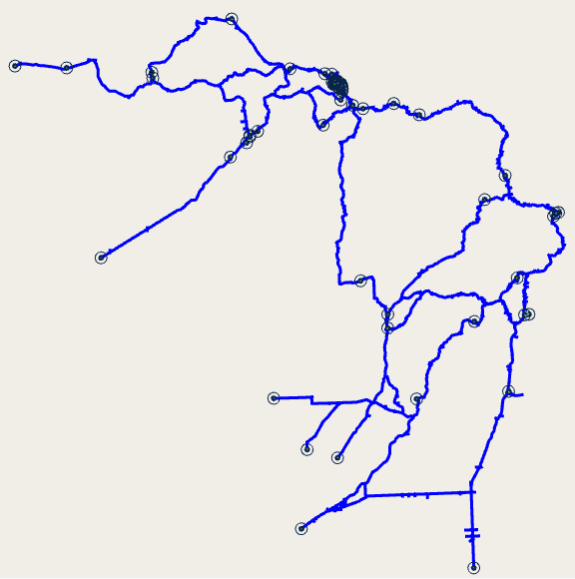
Case Study: How Many Charging Stations are Needed? Where to Place Them?
C
An alternative scenario: With three fixed charging stations added
Location A: @Madera County Fire Station 15 → 5 DCFC chargers at 250KW
Location B: @Valera Gas Station → 5 DCFC chargers at 250KW
Location C: @Mariposa Co. Fire Station 25 Mt Bullion/Airport → 10 DCFC chargers at 250KW
B
A
Results Averaged Over 5 Simulation Runs
EV Percentage |  | 10% | 20% | 30% | 40% | 50%
Total VMT (miles) | Baseline Scenario | 45229 | 46204 | 46118 | 46411 | 44323
 | Alternative Scenario | 44944 | 45859 | 46601 | 46508 | 45933
Energy Demand (KWH) | Baseline Scenario | 784.33 | 1621.28 | 2504.84 | 3329.22 | 4057.56
 | Alternative Scenario | 792.97 | 1611.15 | 2513.48 | 3312.24 | 4125.68
# of EVs Failed to Find a Charging Station | Baseline Scenario | 13 | 27 | 44 | 52 | 62
 | Alternative Scenario | 6 | 16 | 19 | 29 | 34
# of EVs Run Out of Battery* | Baseline Scenario | 1 | 7 | 11 | 11 | 14
 | Alternative Scenario | 2 | 6 | 8 | 10 | 13
The increase in charging station availability will reduce the need to travel a long distance for charging.
The increase in charging station availability will increase the chance for an EV to find a charging station nearby.
*EVs that run out of battery will be removed from the network/simulation.

Slide 25
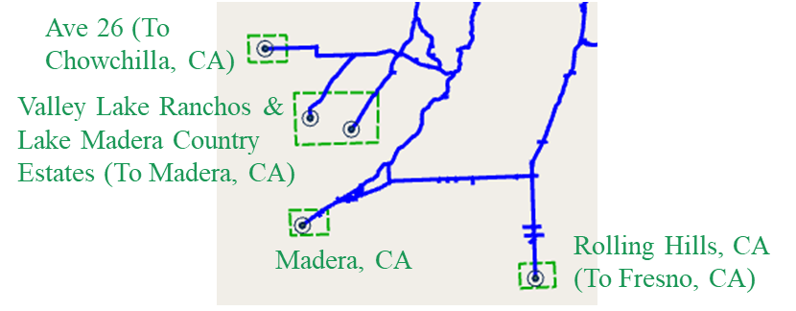
Case Study: Evacuation with/without Mobile Charging Stations (1/2)
Proposed Evacuation Event
A wildfire near Mariposa forces the residents to evacuate to the south (Madera, CA)
Global settings
20% EV
Low at-home charge rate in the evacuation zone(s) ~ N(50%, 30%)
High at-home charge rate for other locations~ N(80%, 30%)
Evacuation starts at 8:15AM, till the end of simulation (9AM)
SOC Thresholds: Low SOC at 30%, Targeted SOC at 60%
Scenarios
A baseline scenario: With existing fixed charging stations
An alternative scenario: Three 600KWH mobile charging stations with 4 DCFC ports @ 150KW and 2 L2 ports @ 16KW
Location A @Mariposa County Fire Department
Location B @California State Mining & Mineral Museum
Location C @Madera County Fire Station 15
A
B
C

Slide 26
Case Study: Evacuation with/without Mobile Charging Stations (2/2)
20% EV & Results Averaged Over 5 Simulation Runs
Total VMT (miles) | Baseline Scenario | 37732.95
 | Alternative Scenario | 38230.3
Energy Demand (KWH) | Baseline Scenario | 1436.3
 | Alternative Scenario | 1499.69
# of EVs Failed to Find a Charging Station | Baseline Scenario | 63
 | Alternative Scenario | 22
# of EVs Run Out of Battery* | Baseline Scenario | 7
 | Alternative Scenario | 4
The deployment of MCSs significantly increases the chance for an EV to be charged in a timely manner and thus enhances the efficiency and resilience of the transportation system during emergency evacuations.
*EVs that run out of battery will be removed from the network/simulation.
Mobile Charging Station Statistics (At the End of Simulation)
Station Name | Battery Consumed (KWH) | # of EVs Served | # of EVs Being Charged | # of EVs Waiting | # of EVs In Route
@Mariposa County Fire Department | 108 | 8 | 4 | 0 | 5
@California State Mining & Mineral Museum | 32 | 3 | 2 | 0 | 7
@Madera County Fire Station 15 | 115 | 8 | 3 | 0 | 9

Slide 27
Part III: Next Steps

Slide 28
Next Steps: Model Calibration
Data Requirements
PeMS Vehicle Detector Station (VDS) data
Average Daily Traffic (ADT) data (probably from PeMS)
OD demand data from regional travel demand models (Need help on this)
Household data and car ownership data in the town of Mariposa (Need help on this)
A few traffic signal control plans (less than 10 in our network; need help on this)

Slide 29
Next Steps: Strategies for MCS Placement
We will implement strategies that dynamically allocate/place MCSs to the candidate locations to minimize the total/average evacuation time, based on the real-time information of
Network traffic status
Road closures
Status of charging stations
Etc.

Slide 30
Thanks!

Slide 31
Why Aimsun?
In this study, we chose the commercial software, Aimsun, for the following reasons:
Aimsun has embedded the EV model for “Car”.
https://www.aimsun.com/technical-notes/mfc-and-battery-consumption-model/
Note: SUMO has a module for EV and Charging Station.https://sumo.dlr.de/docs/Models/Electric.html#stopping_at_a_charging_station
Aimsun is one of the prevailing commercial microsimulation tools available in the market. It can import the networks from other commercial software tools like Vissim and Paramics.
Commercial tools normally have better GUI support and more features available to support various needs of the stakeholders.
Aimsun has the Vehicle-to-Everything (V2X) module to further extend the evaluation platform developed in this study for Connected and Automated, Electric Vehicles (CAEVs).

